Slide 1


Progress Report: 10
Team Charlie
Aakansha Bhatt, Anshu Paudyal, Ingmar Diaz, Michael Foster, Raunaq Chopra, Yang Ye
March 11th 2021

Slide 2
Aakansha Bhatt
Last week 9 | This week 10
Hardware: N/A | Hardware: N/A
Mechanical: N/A | Mechanical: Helped Anshu figure out how to get the H-bridge to work and helped figuring out using a potentiometer.
Firmware: | Firmware: Tried working on the PWM to make motor work.
Software: N/A | Software: N/A

Slide 3
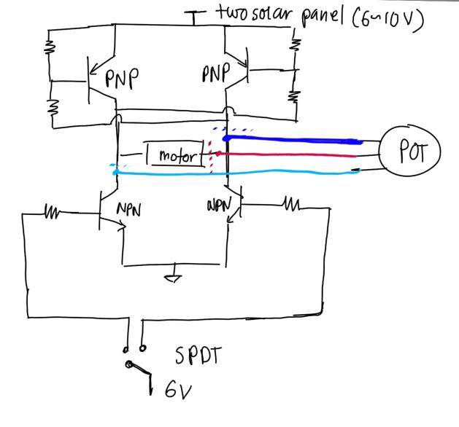
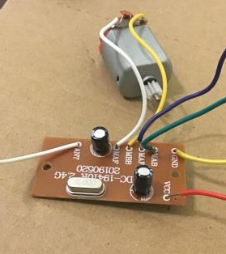
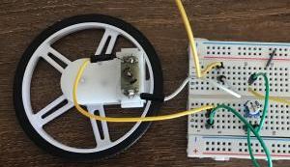
Anshu Paudyal
Week 9 & 10
More testing on the PCB of the rover → got no where
Created H-bridge using P channel, N channel mosfet, and SPDT switches
PWM signal generated → having some hard time getting it working with the H-bridge IC and the motor.
Potentiometer used for speed variation successfully achieved
Also:
Documentation
Made changes according to the feedback given
http://www.learningaboutelectronics.com/Articles/H-bridge-circuit-with-transistors.php

Slide 4
Ingmar Diaz
Last week 9 | This week 10
Hardware: | Hardware:
Mechanical: | Mechanical:
Firmware: Implemented voltage divider into power analysis circuit and was able to scale up the values. However, having trouble correctly displaying into OLED need to research more on Graphics Library and variable types and functions in C. | Firmware: Still have not been able to display adc values on OLED. I have researched for numerous hours. Also, talked to another team that was able to display voltage values. Planning to meet with nick in office hours today.
Software: | Software:

Slide 5
Michael Foster
Last Week: 9 | This Week: 10
Hardware: N/a | Hardware: N/a
Mechanical:N/a | Mechanical:N/a
Met with group to figure out what are the next steps to this project. Was only able to spend a day researching and working. I’ve had to put more energy into my other classes this week since I have two design | Need to meet up with group members and finalize the project, by finishing the Beta technical report. Also need to talk about how we’re going to accomplish the marketing video.
Projects due Friday and Saturday. Will continue to work on senior design this weekend

Slide 6
Raunaq Chopra
Week 8:
Week 9:

Slide 7
Yang Ye

Slide 8
Bill of Materials and Project Budget:
https://docs.google.com/document/d/1Z8hYnIozI8YJ1Gv2Vyb1GQ2SpYeY4Tan/edit

